Slide 1

Algorithm And Problem Solving

Slide 2
Introduction to Algorithm
What is an Algorithm:
An algorithm is a step-by-step procedure to solve a problem or perform a task.
Key Characteristics:
Input: The algorithm receives input(s).
Output: Produces output(s).
Definiteness: Each step is clearly and unambiguously defined.
Finiteness: It terminates after a finite number of steps.
Effectiveness: Each operation must be basic enough to be done exactly.
Example:
Problem: Add two numbers
Algorithm:
1. Start
2. Read two numbers a and b
3. Compute sum = a + b
4. Output sum
5. End

Slide 3
Complexity
Complexity is quantitative measure of how an algorithm performs relative to the size of its input.
Time Complexity
Time complexity measures how the execution time of an algorithm increases with input size n.
Space Complexity
Space complexity measures how the memory usage grows with input size n.
How to Calculate Time Complexity
Loops:
for (i = 0; i < n; i++) ⇒ O(n)
Nested loop ⇒ O(n^2)
Recursive calls:
T(n) = T(n/2) + O(1) ⇒ O(log n)
Use recurrence relations or the recursion tree method
Dividing problems:
Merge Sort ⇒ divides into 2 and merges ⇒ O(n log n)

Slide 4
Complexity Rules
1. Count the Number of Basic Operations
An assignment (a = b), A comparison (i < n), An arithmetic operation (a + b), A function call (if complexity is known)
2. Focus on the Worst Case
When analyzing time complexity, we usually use Big-O notation, which describes the worst-case performance.
int i = 0;
while (i < n) {i++;}
Even if i stops early in some cases, we care about the maximum number of iterations → O(n).
3. Ignore Constants and Lower-Order Terms
Only keep the dominant term.
O(2n) becomes O(n), O(n + log n) becomes O(n), O(n² + n) becomes O(n²)
4. Loops Rule
Single Loop
for (int i = 0; i < n; i++) {// O(1) work} → O(n)
Nested Loops
for (int i = 0; i < n; i++) {
for (int j = 0; j < n; j++) {// O(1) work}} → O(n * n) = O(n²)
Sequential Loops
for (int i = 0; i < n; i++) {} // O(n)
for (int j = 0; j < n; j++) {} // O(n) → O(n) + O(n) = O(n)

Slide 5
Complexity Rules
5. Recursive Time Complexity
Use recurrence relations.
Example: Merge Sort
T(n) = 2T(n/2) + O(n)
This solves to: O(n log n)
Use the Master Theorem or recursion tree to solve recurrence relations.
6. Conditions and Branches
if (condition) {
// O(n)
} else {
// O(1)
}
Worst case is what matters → O(n)
7. Function Calls
If a function has O(f(n)) time complexity and it's called g(n) times:
→ Total time = O(f(n) * g(n))

Slide 6
Brute Force
Brute Force is the most straightforward approach to solving a problem: try all possible solutions and pick the correct or optimal one. It requires little to no insight into the problem's structure
Key Features:
Simple to implement
Often the first approach during brainstorming
Useful for small input sizes or when no optimized algorithm is known
Example: Given an sorted array of integers arr and a target sum target, return true if there are any two numbers in the array that add up to target.
Input:
int[] arr = {1, 3, 5, 7, 9, 11};
int target = 10;

Slide 7
Divide and Conquer
Divide and Conquer is a recursive problem-solving technique that breaks a problem into smaller subproblems, solves them independently, and combines their results.
3 Phases:
Divide: Split the problem into smaller parts.
Conquer: Recursively solve each subproblem.
Combine: Merge the sub-solutions into the final answer.
2.2. Example:
The classic example is Merge Sort.
Input:
int[] arr = {2, 7, 11, 15};
int target = 9;

Slide 8
Bubble Sort
Bubble Sort is a simple comparison-based sorting algorithm that repeatedly steps through the list, compares adjacent elements, and swaps them if they are in the wrong order.This process is repeated until the list is sorted.
Step-by-Step Working
Let’s sort this array in ascending order:
Input: arr = {5, 3, 8, 4, 2}
Pass 1:
Compare and swap adjacent elements:
5 > 3 → swap → {3, 5, 8, 4, 2}
5 < 8 → no swap
8 > 4 → swap → {3, 5, 4, 8, 2}
8 > 2 → swap → {3, 5, 4, 2, 8}
Largest element (8) is now at the end.
Pass 2:
3 < 5 → no swap
5 > 4 → swap → {3, 4, 5, 2, 8}
5 > 2 → swap → {3, 4, 2, 5, 8}
5 < 8 → no swap
Second largest element (5) in place. Repeat until the array is fully sorted.
When NOT to Use Bubble Sort
For large datasets (very inefficient)
When performance matters
Complexity: O(n²)

Slide 9
Selection Sort
Selection Sort is a simple comparison-based sorting algorithm. It works by repeatedly selecting the smallest (or largest) element from the unsorted part of the array and moving it to the beginning.
Step-by-Step Example
Let’s sort this array in ascending order:
Input: arr = {5, 3, 8, 4, 2}
Pass 1:
Scan entire array to find smallest → 2
Swap it with the first element → {2, 3, 8, 4, 5}
Pass 2:
Look in remaining {3, 8, 4, 5} → smallest is 3
Already in place → no change
Pass 3:
Find smallest in {8, 4, 5} → 4
Swap with 8 → {2, 3, 4, 8, 5}
Pass 4:
Find smallest in {8, 5} → 5
Swap with 8 → {2, 3, 4, 5, 8} Array is sorted.
When Not to Use
Large datasets
Time-critical applications
Already or nearly sorted data
Complexity: O(n²)

Slide 10
Merge Sort
Merge Sort is a divide-and-conquer algorithm that:
Divides the array into halves recursively until each subarray has one element.
Conquers by sorting and merging those subarrays back together into a fully sorted array.
Step-by-Step Example
Let’s sort the array:
Input: arr = {5, 3, 8, 4, 2, 7, 1}
1. Divide the array
[5, 3, 8, 4, 2, 7, 1]
→ [5, 3, 8] and [4, 2, 7, 1]
→ [5], [3, 8] and [4, 2], [7, 1]
→ [5], [3], [8] and [4], [2], [7], [1]
2. Merge back while sorting
[3], [8] → [3, 8]
[5], [3, 8] → [3, 5, 8]
[2], [4] → [2, 4]
[1], [7] → [1, 7]
[2, 4], [1, 7] → [1, 2, 4, 7]
[3, 5, 8], [1, 2, 4, 7] → [1, 2, 3, 4, 5, 7, 8]
When to Use Merge Sort
You need guaranteed O(n log n) performance
Data is stored in a linked list
Stability matters (e.g. preserving original order of equal items)
Complexity: O(n log n)

Slide 11
Quick Sort
Quick Sort is a divide-and-conquer algorithm that:
Picks a pivot element from the array.
Partitions the array so that:
Elements less than the pivot go to the left,
Elements greater than the pivot go to the right.
Recursively applies the above steps to left and right subarrays.
Step-by-Step Example
Input: arr = {5, 3, 8, 4, 2, 7, 1}
Assume we always pick the last element as the pivot.
First Call:
Pivot = 1
Partition: move all smaller elements to left → 1 ends up at index 0
Array: [1, 3, 8, 4, 2, 7, 5]
Recurse on [ ] and [3, 8, 4, 2, 7, 5]
Next Pivot = 5 (end of right part)
Partition: [3, 4, 2] < 5, [8, 7] > 5
Place 5 at correct position
Array: [1, 3, 4, 2, 5, 8, 7]
Recurse on [3, 4, 2] and [8, 7] Repeat
When Not to Use
If worst-case time must be avoided (e.g., security)
On already or nearly sorted arrays (unless randomized)
Complexity: O(log n2)

Slide 12
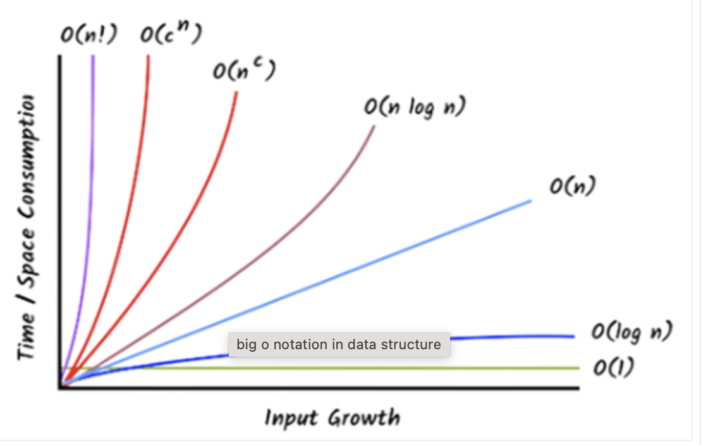

Slide 13
Binary search
Binary Search is a divide-and-conquer algorithm that:
Repeatedly divides the search interval in half.
Compares the target value with the middle element of the current interval:
If equal, the search is successful.
If the target is smaller, it searches the left half.
If the target is larger, it searches the right half.
Continues until the element is found or the interval is empty.
Step-by-Step Example
Input: arr = {1, 3, 5, 7, 9, 11, 13}, target = 9
First Step:
Low = 0, High = 6
Middle index = (0 + 6) // 2 = 3
arr[3] = 7 → 9 > 7 → Search right half
Second Step:
New Low = 4, High = 6
Middle index = (4 + 6) // 2 = 5
arr[5] = 11 → 9 < 11 → Search left half
Third Step:
New Low = 4, High = 4
Middle index = (4 + 4) // 2 = 4
arr[4] = 9 → Found!
When Not to Use
On unsorted arrays (unless you sort them first).
When the array is very small and linear search would be simpler.
Complexity: Average and Worst case: O(log n)

Slide 14
hashing
Hashing is a technique to map data (like keys) to a fixed-size value (index) using a hash function.
Think of hashing like assigning each book in a library to a numbered shelf using a smart rule (hash function). When you want a book, the rule tells you exactly which shelf to check.
Uses of Hashing
Implementing HashMap, HashSet, Hashtable
Fast data retrieval (average O(1) time)
Storing passwords securely (via cryptographic hashes)
Checking file integrity (MD5, SHA-256)
Component: Description
Key: The data you want to store (e.g., "apple", 42)
Hash Function: Converts key to an integer (index)
Hash Table: Array where data is stored using the index from hash function
Ideal Hash Function:
Deterministic (same input → same output)
Uniform (distributes keys evenly)
Fast to compute
Handles all input types

Slide 15
hashing techniques
When two keys produce the same hash index,it’s called
a collision. Hashing techniques define how to handle this.
1. Chaining (Separate Chaining)
Each slot of the table stores a linked list of entries
Collisions are stored in the list
Example:
Index 0 → null
Index 1 → [21 → 41 → 11]
Pros:
Simple to implement
No need to resize on many collisions
Cons:
Slower in worst case (linked list lookup)
2. Open Addressing (Linear Probing)
All data is stored in the hash table itself
On collision, search next empty cell (+1, +2, etc.)
Insertion:
Index = hash(key)
If occupied → try index + 1, index + 2, ...
Pros:
Uses less memory (no linked lists)
Cons:
Clustering (many keys end up next to each other)
Let’s say:
Table size m = 7
Hash function: h(k) = k % 7
Insert keys: 10, 3, 17, 24 ,31
Step-by-step:
10 % 7 = 3 → Slot 3 is empty → Store 10 at index 3
3 % 7 = 3 → Slot 3 is full → Try 4 → Store 3 at index 4
17 % 7 = 3 → Try 3 (full), 4 (full), 5 → Store 17 at index 5
24 % 7 = 3 → Try 3 (full), 4, 5, 6 → Store 24 at index 6

Slide 16
hashing techniques
3. Quadratic Probing
Like linear probing, but probes quadratically: hash + 1², hash + 2², hash + 3², ...
Let’s assume:
Hash function: h(k) = k % 7
Table size = 7
Keys to insert: 10, 20, 30, 23
Inserting 10:
10 % 7 = 3 → index 3 is empty → insert at 3
Inserting 20:
20 % 7 = 6 → index 6 is empty → insert at 6
Inserting 30:
30 % 7 = 2 → index 2 is empty → insert at 2
Inserting 23:
23 % 7 = 2 → index 2 is full Try:
i=1 → (2 + 1²) % 7 = 3 → full
i=2 → (2 + 4) % 7 = 6 → full
i=3 → (2 + 9) % 7 = 4 → empty → insert at 4
Pros: Reduces primary clustering seen in linear probing.
Simple to implement.
Better distribution of keys compared to linear
Cons: May still fail if load factor is high
4. Double Hashing: It uses a second hash function to calculate the step size (interval) for resolving collisions. index = (hash1(key) + i * hash2(key)) % size;
Why Double Hashing?
To avoid primary and secondary clustering.
In linear probing, clusters form easily.
In quadratic probing, keys with the same hash follow the same probe sequence.
But with double hashing, different keys have different probe sequences, even if their first hash matches.
Hash Function in Double Hashing
h1(k) be the first hash function (to find the index)
h2(k) be the second hash function (to find step size)
i be the probe number
Probe Formula:
index = (h1(k) + i * h2(k)) % tableSize
Advantages of Double Hashing
No clustering (avoids both primary and secondary)
Uses full table more effectively than quadratic probing
Best performance among open addressing methods
Pros: Best collision resolution for open addressing
Cons: Slightly complex
Second hash function must be chosen carefully Still degrades when load factor is high

Slide 17
hashing techniques
Try probes:
Probe 0: ndex=(h1​(17)+0×h2​(17))mod7=(3+0×3)mod7=3
Check index 3 → Occupied by 10 → collision!
Probe 1:
i ndex=(3+1×3)mod7=(3+3)mod7=6
Check index 6 → Occupied by 20 → collision again!
Probe 2:
index=(3+2×3)mod7=(3+6)mod7=9mod7=2
Check index 2 → Empty → insert 17 here
Example
Let’s assume:
tableSize = 7
h1(k) = k % 7
h2(k) = 5 - (k % 5)
→ ensures step size is not 0 and is different for different keys
Insert keys: 10, 20, 15, 17
Insert 10:
h1 = 10 % 7 = 3
h2 = 5 - (10 % 5) = 5 - 0 = 5
index = 3 → empty → insert
Insert 20:
h1 = 20 % 7 = 6
h2 = 5 - (20 % 5) = 5 - 0 = 5
index = 6 → empty → insert
Insert 15:
h1 = 15 % 7 = 1
h2 = 5 - (15 % 5) = 5 - 0 = 5
index = 1 → empty → insert
Insert 17:
h1 = 17 % 7 = 3
h2 = 5 - (17 % 5) = 5 - 2 = 3

Slide 18
Recursion
Recursion is a programming technique where a method calls itself to solve smaller instances of the same problem.
How It Works:
If you call factorial(5), it breaks the problem down like this:
factorial(5)
= 5 * factorial(4)
= 5 * 4 * factorial(3)
= 5 * 4 * 3 * factorial(2)
= 5 * 4 * 3 * 2 * factorial(1)
= 5 * 4 * 3 * 2 * 1
= 120
Key Concepts:
Base case: The condition where recursion stops (n == 0 || n == 1)
Recursive case: The method calls itself with a smaller input (n - 1)
Complexity: O(n)

Slide 19
Backtracking
It’s a way of solving problems by trying out different options step by step.
If you find that a certain path doesn’t work, you go back (or "backtrack") and try a different one.
It helps you find the right solution by exploring all possibilities, but only as much as needed.
How It Works (Backtracking Steps):
Start with an empty subset []
At each step, you either:
Include the current number
Skip it and move to the next
After each inclusion, call the function recursively
After recursion returns, remove (backtrack) the last element and try the next path
Key Concepts:
Base case: The condition where recursion stops (n == 0 || n == 1)
Recursive case: The method calls itself with a smaller input (n - 1)
Complexity: O(2ⁿ × n)
{1,2,3}

Slide 20
END

